Slide 1
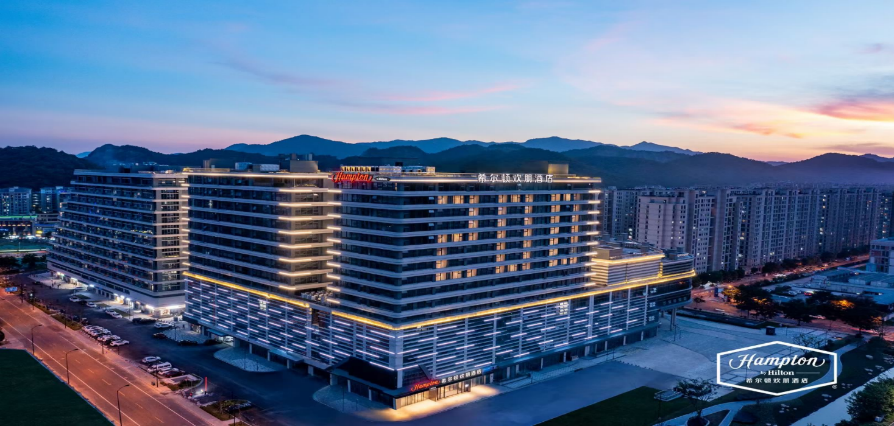
希尔顿欢朋酒店前台业务
培训课件
杭州转塘美院希尔顿欢朋酒店简介
Hampton by Hilton Hangzhou Zhuan Tang Art College Introduction
运营部
operation center

Slide 2
目 录
CONTENTS
01
品牌简介（Brand introduction）
02
酒店简介（Hotel introduction）

Slide 3
马尼拉康莱德酒店
Hilton ( NYSE : HLT ) is an internationally renowned hotel management company with 18 outstanding hotel brands. It directly manages, franchises, holds and leases more than 6,100 hotels and more than 970,000 rooms in 119 countries and regions around the world. Hilton has always been committed to being a representative of hospitality in the world 's hospitality industry and ranked second in the Institute for Workplace Excellence 's 2019 World 's Best Place to Work award, making it the world 's highest ranked hotel group. In the course of a hundred years of development, Hilton Hotel has provided services for more than 3 billion guests. At the same time, as an award-winning loyalty program, Hilton Honors has provided more than 13 million members around the world with a value-for-money point-for-point accommodation experience, as well as electronic check-in and selection of guest rooms, digital keys and smart rooms.

Slide 4
Total number of brands
Total hotels
Countries and regions
of the world
Hilton Honors Member
Hilton Global development
Total number of rooms
Total number of rooms
to be built
Global members
Total number of guests served per year

Slide 5
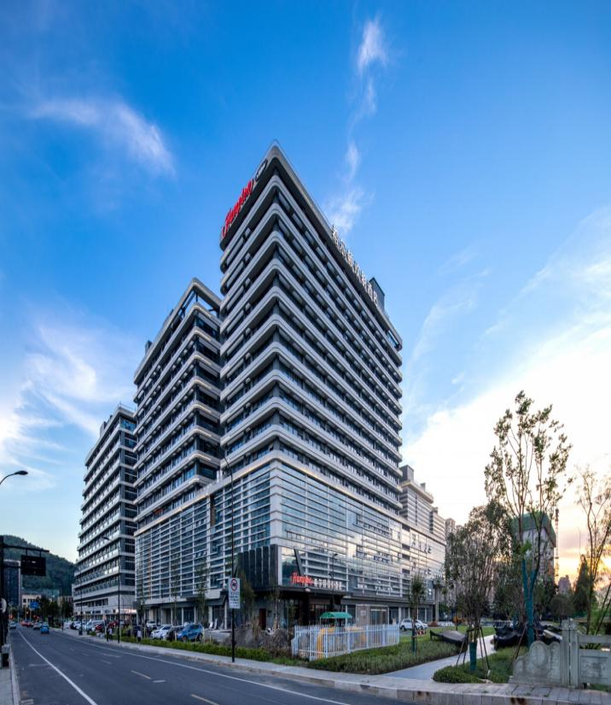
Hampton by Hilton Foshan Sanshui
Hampton by Hilton
Hampton by Hilton is one of Hilton 's largest hotel brands. In 1984, the world 's first Hilton Friends Hotel opened in Memphis, the United States.Since then, the Hilton Friends Hotel has rapidly expanded its business and has opened more than 2,500 hotels in 30 countries ( including the United States, Canada, Russia and Germany ). In 2014, Hilton Friends entered China.In addition to many characteristic services that have made the Friends brand successful in the world, including healthy breakfast, free WiFi, refreshing bed, and friendly, reliable, caring, and comprehensive services provided by hotel members, it is worth the guests to expect Chinese localized facilities and services.
济南莱芜希尔顿欢朋酒店

Slide 6
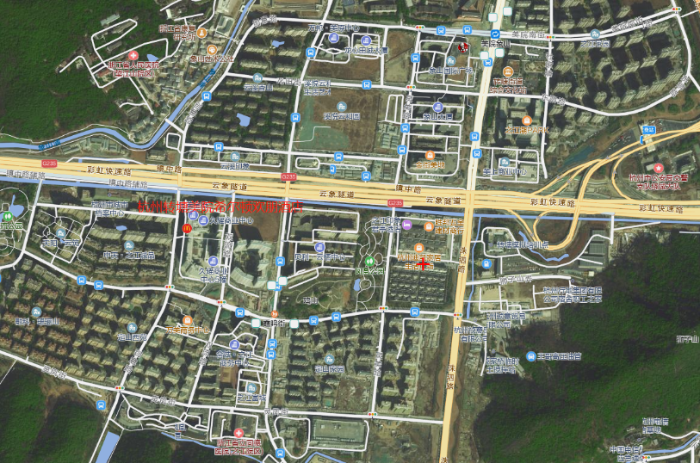
Hampton by Hilton Hangzhou Zhuan Tang Art College
Hotel Overview-Geographical
Location and Transportation Guide
Hilton Hampton Inn Hangzhou Zhuantang, the 200 th opening hotel of Hilton Hampton China, is located in No.2 Building of Jiuyao Commercial Center, Zhuantang Street, Xihu District, Hangzhou City, next to Xiaming Street Metro Station of Metro Line 6, only about 500 meters on foot ; it is located in the business circle of Songcheng Academy of Fine Arts in Hangzhou. It starts from Qiantang River in the east and reaches Fuyang in the west. It is bordered by Shuangpu Town in the south and leaves streets in the north. Many historical monuments such as ancient seawalls and ancient bridges in the street have accumulated strong cultural heritage together with institutions of higher learning such as China Academy of Fine Arts and Zhijiang College of Zhejiang University of Technology. Longwu Tea Village, Daqinggu Scenic Area, Bailongtan Scenic Area, Zhijiang International Golf Course, Songcheng and other large leisure playgrounds are dotted among green mountains. and rivers, forming an area where Hangzhou 's top villas gather.

Slide 7
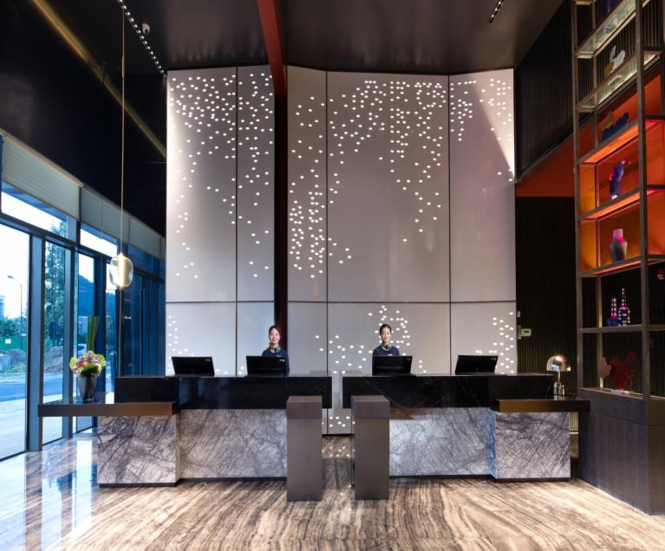
Hampton by Hilton Hangzhou Zhuan Tang Art College
There is paradise on the top and Suhang on the bottom. There are countless places of interest and historic sites. This is the most beautiful Hangzhou. Quality as one, beyond expectations, more than 30 years of excellent service reputation, more than 2400 hotels around the world, here is the Hilton Friends Hotel. The Hilton Happy Friends Hotel Hangzhou Zhuantang Academy of Fine Arts inherits the high quality of Hilton Happy Friends as always, and is committed to bringing a comfortable and pleasant stay experience to the majority of business elites and parent-child families. Even on a busy journey, you can enjoy the exciting time of gathering friends. The hotel is located in the central area of Zhuantang, Hangzhou, with convenient transportation and elegant environment. It is 500 meters away from the subway. It pursues international taste and style, pays attention to service experience, and allows all customers to feel the warmth of relatives and friends during the journey. Warm and comfortable rooms, feature-rich conference rooms, active gyms, and healthy restaurants with pure tastes... intimate service only for more understand you, Hilton friends, so that every time you check-in feel comfortable, happy ever simple !

Slide 8
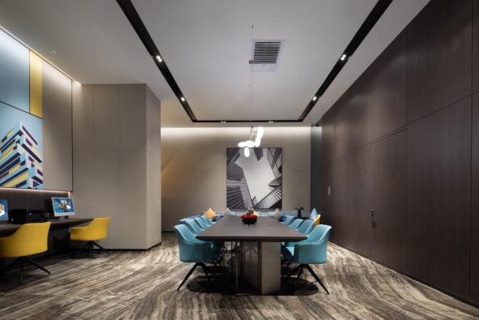
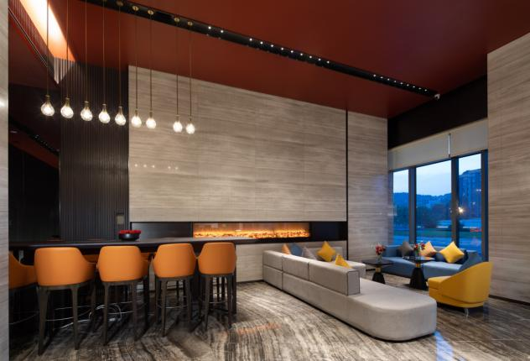
Multifunctional HUB lobby
Sharing | Gathering | Close
Meet the multiple needs of leisure and office
Fashion modern design
Comfortable environment and relaxed atmosphere
Free Welcome Beverage Area
Provide computer and printer services

Slide 9
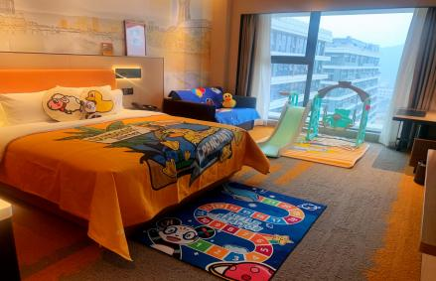
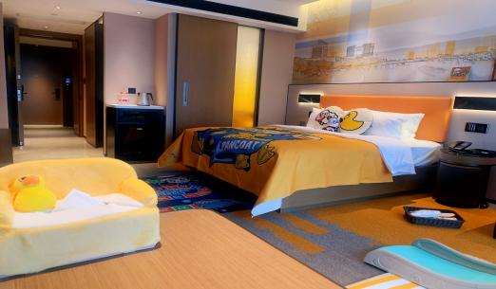
Guest room-parent-child room
Comfort | quiet | sweet dream
Equipped with children 's supplies
Pay attention to the travel needs of parent-child families and provide supplies for children to travel.
Sofa bed
Just two steps to flip easily, a second time, a leisure sofa immediately turned into a comfortable bed. It can not only retain the pleasant time of friends, but also extend the sleep space of parent-child families.

Slide 10
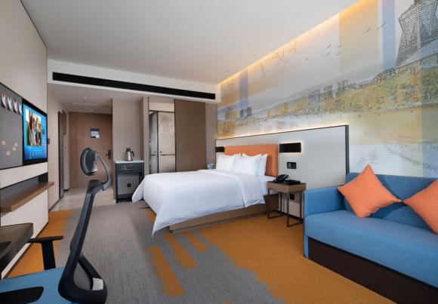
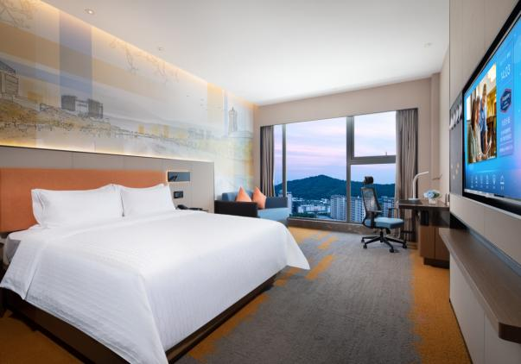
Room - Superior Big Bed Room
The modern design style of light and warm colors and the ingenious spatial layout bring you a warm and comfortable experience.
The US ' Hampton BedÂ ® ' standard Serta double patent mattress with eco-certified bedding to create a cloud-based sweet dream experience.

Slide 11
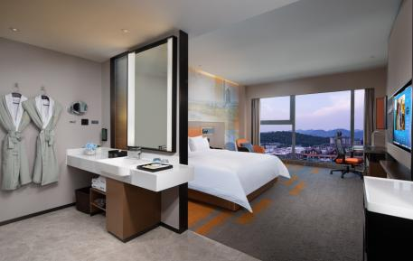
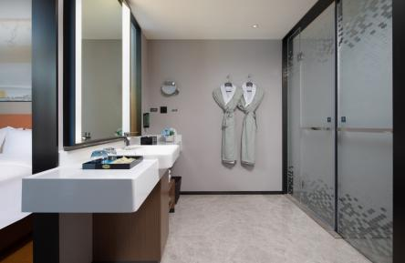
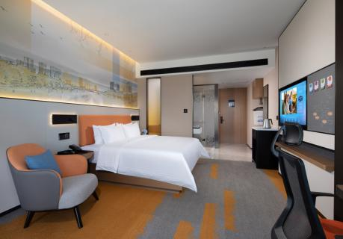
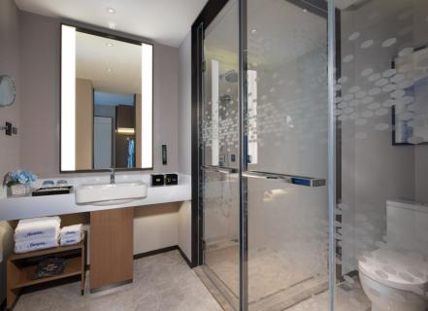
Deluxe Mountain View Big Bed Room
Peter Thomas Roth, a hall-level medical brand in the field of skin care in the United States, effectively relieves fatigue with its pure natural ingredients and soothing bathing feelings.
With just two easy flips, a lounge sofa instantly transforms into a comfortable 1.5-metre bed. Extend the sleep space of parent-child families.

Slide 12
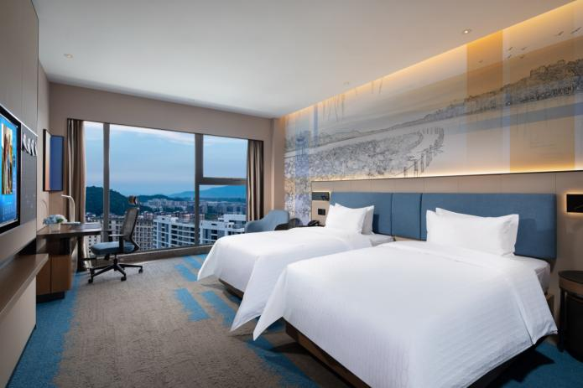
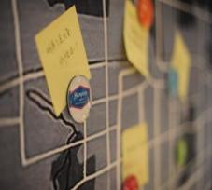
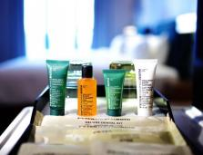
Superior Twin Room
The modern design style of light and warm colors and the ingenious spatial layout bring you a warm and comfortable experience.
The US ' Hampton BedÂ ® ' standard Serta double patent mattress with eco-certified bedding to create a cloud-based sweet dream experience.

Slide 13
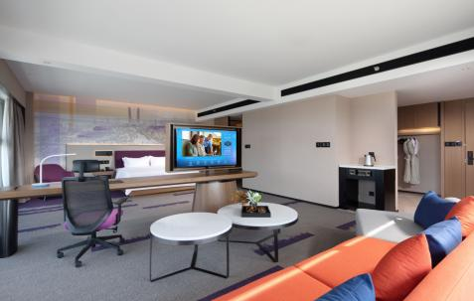
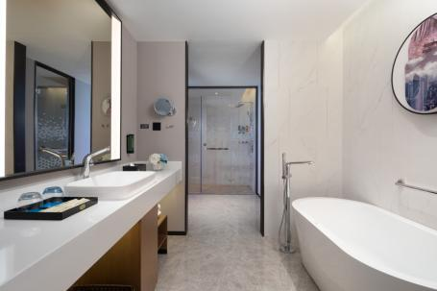
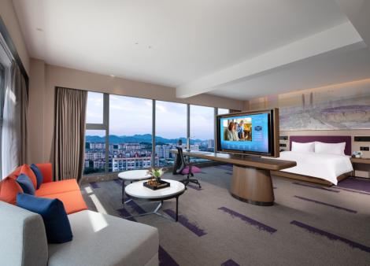
Hampton Suite
The modern design style of light and warm colors and the ingenious spatial layout bring you a warm and comfortable experience.
The US ' Hampton BedÂ ® ' standard Serta double patent mattress with eco-certified bedding to create a cloud-based sweet dream experience.

Slide 14
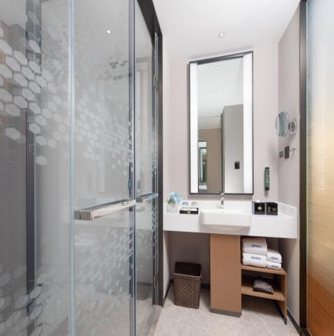
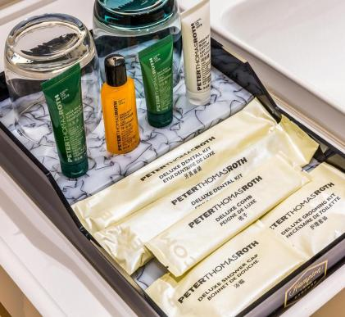
Comfortable shower experience
Fashion simple design and international first-line brand bathroom equipment, bring a comfortable bathing experience ; peter Thomas Roth, a hall-class medical brand in the field of skin care in the United States, can effectively wash away the fatigue during the journey with its pure natural ingredients and soothing fragrance.

Slide 15
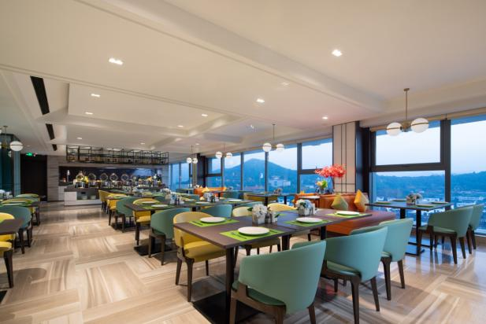
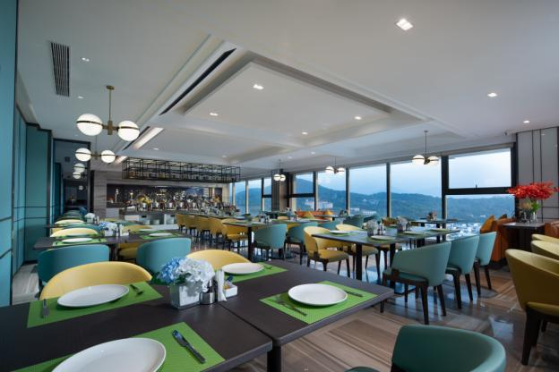
Healthy Style Restaurant
Health | Style | Joy
The simple modern environment, fresh and nutritious hot breakfast, a variety of Western simple meals and fruit and vegetable drinks create a healthy eating experience and add a joy and peace of mind to the busy journey.

Slide 16
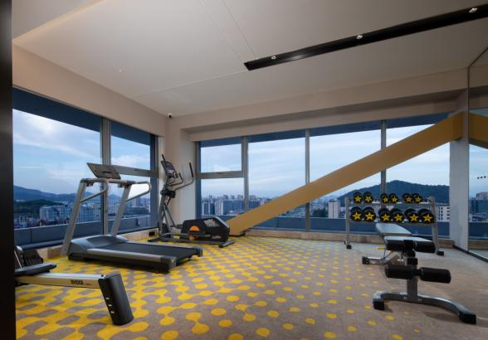
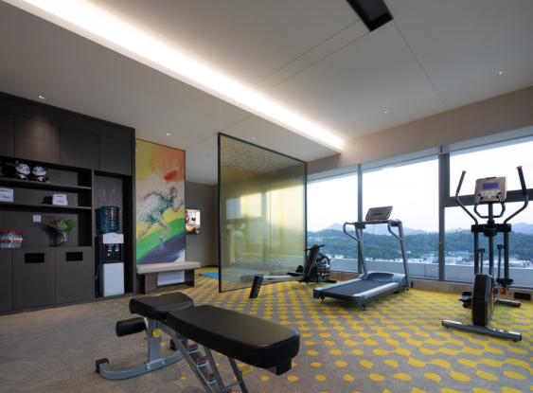
Ledong Gym
Stretch | Relax | Joy
Equipped with global first-tier brands of fitness equipment and equipment, let you sweat, reshape the vitality. Fitness balls, yoga mats, etc.provide multiple choices for exercise.

Slide 17
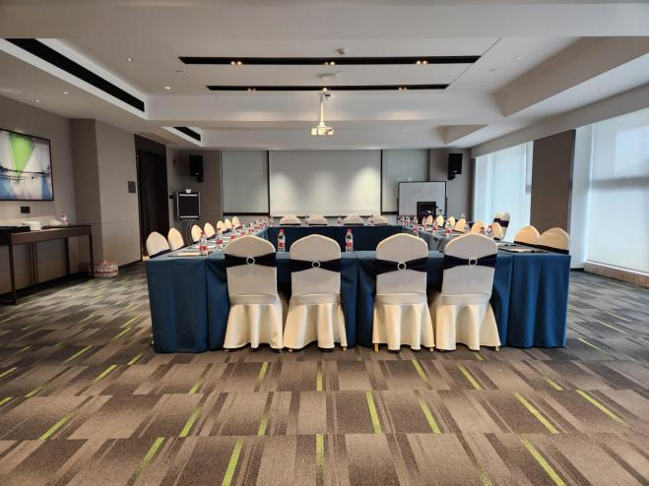
Elite conference room
Professional | Smooth | Innovation
100 square meters multi-functional conference room ; projector ; theme tea break ; business Center Services Creative meeting planning ; careful arrangement of details A full set of professional conference equipment to meet your business office and conference needs, innovative theme tea break, promote all your business inspiration.

Slide 18
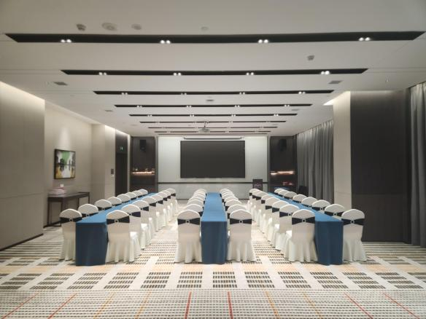
Multifunctional conference hall
Professional | Smooth | Innovation
200 square meters multi-function conference hall can accommodate 120 people ; lED screen ; high-tech audio-visual system ; desk-style, island-style, theater-style combination of a variety of meetings arranged Innovative theme tea break, banquet dining.

